Slide 1
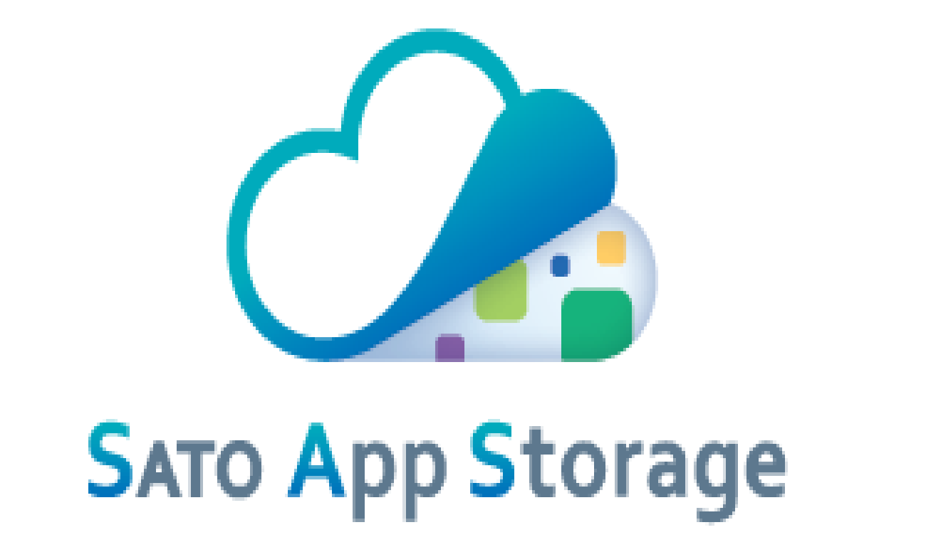
Mar.11.2021
Rev.2.2
SATO App Storage
Security Information
SATO CORPORATION

Slide 2
Security of SATO App Storage
Item | Contents
Cloud Certification (Note: The security and compliance standards are from SAS cloud service provider. SAS application is not certified for these standard) | Cloud with the world's most stringent security and compliance standards. Cloud with the world's most stringent security and compliance standards. A cloud environment with the following major compliance certifications worldwide. ISO 27001, ISO 27018, SOC 1, SOC 2, SOC3, FedRAMP, HITRUST, MTCS, IRAP, ENS, etc.
DDos attack protection | Detect DDoS attacks in real time, such as monitoring network traffic and automatically reducing attacks, and prevent and reduce attacks.
SSL/TLS certificate | Data encryption by enterprise certification
Virus scan | Scan for viruses when uploading files.
Diagnosed vulnerability | Web application has tested a vulnerability assessment by a third party company.

Slide 3



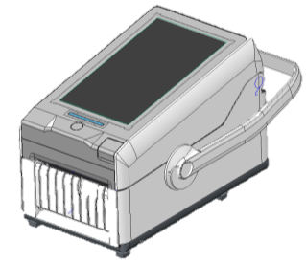

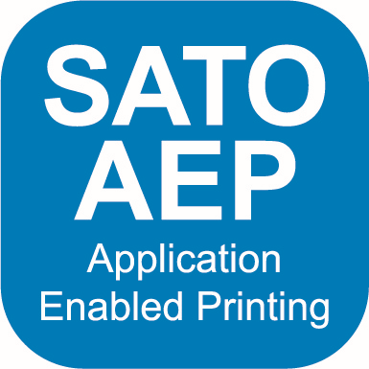
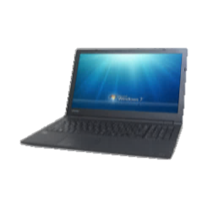

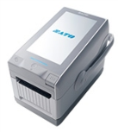



System architecture
<Note>
Port number 443 goes through the firewall
In order to connect the printer to SATO App Storage, you need an environment that can communicate with the Internet from the customer's internal network.
※ When a proxy or firewall is installed
Group & Account
Storage
Head
quarter
A store
Printer ⇔ SAS
HTTPS(443)
File download
MQTT over WebSocket(443)
Push notification
Upload print log
PC ⇔ SAS
HTTPS(443)
Check the download status
Group/Account registration
SATO or Business Partner
AEP tool ⇔ SAS
HTTPS(443)
File upload
File download
Customer
AEP tool ⇔ SAS
HTTPS(443)
1) AEP tool
Make/Upload Application file
2) SATO App Storage
Group/Account registration
A Store
Application Design Tool
PC browser
Windows
IE10/11
AEP tool
Chrome
Headquarter

Slide 4
Information sent to SAS and registered
This service registers the following information.
Item | Contents
User group information | Company ID, Company name, Business, Name of the PIC, Postal code, Address, Phone number, Country, Language, Time Zone, Memo, Administrator authority(group, account, file)
User account information | Account name, Login ID, Email address, Language, Memo
File information | File name, Type, Summary, Allow pre-download, Distribution date and time(Start/End), Application, Model, Memo, Directory, Display uploaded by, Display modified by
Plan information | Plan, Storage capacity, Number of contracted printers, Contract month(Start/End)

Slide 5
Communication between printer and SAS
Item | Contents
SAS API | Printers/AEP tools use SATO original API when connecting to SAS.
User authentication | Company ID, login ID, password
File download | Printers/AEP tools get the file list registered from SAS. After that, compare the files registered in Printer/AEP tool from the file list and download only the update file or the additional file.
File upload | Printers/AEP tools get the file list registered from SAS. After that, compare the files registered in Printer/AEP tool from the file list and upload the update file or the additional file.

Slide 6
Information necessary for the printer settings
Item | Contents
Printer Network settings IP address Netmask Gateway | It is not necessary for DHCP.
DNS | It is not necessary for DHCP.
Proxy IP address Port number | It is not necessary when not going through a proxy server.
NTP(Network Time Protocol) | Optional setting

Slide 7
Domain name of SATO App Storage
No. | FQDN | Protocol | Port number | Global IP Address | Plan
1 | sato-app-storage.com ※1 | HTTPS | TCP 443 | 20.44.169.5 | File distribution plan Distribution & Log plan
2 | sato-app-storage.blob.core.windows.net ※2 | HTTPS | TCP 443 | Please check the latest Global IP Address published by Microsoft from the following URL. https://www.microsoft.com/en-us/download/details.aspx?id=56519 <Extraction conditions> "name": "Storage.JapanEast", "name": "AzureIoTHub.JapanEast", | File distribution plan Distribution & Log plan
3 | sato-app-storage.azure-devices.net ※2 | MQTT over WebSocket ※3 | TCP 443 |  | Distribution & Log plan *File push distribution *Print log visualization
*1) This is the main FQDN used by the PC and printer.
*2) This FQDN is used only by the printer. Since this FQDN is secure, it cannot be accessed from a PC browser.
*3) MQTT over WebSocket communicates using port 443.
*4) Host name and Global IP Address may be changed in the future.
We recommend "Any" when setting up the firewall.

Slide 8
©2019 SATO HOLDINGS CORPORATION. All rights reserved.
This document is prepared based on information as of March 2021.
Specifications subject to change without notice.
Any unauthorized reproduction of the contents of this presentation, in part or whole, is strictly prohibited.
SATO is a registered trademark of SATO Holdings Corporation and its subsidiaries in Japan, the U.S. and other countries.
All other trademarks are the property of their respective owners.

