Slide 1
Security and Communication
SATO Corporation
November 2021
Revision: 3.1

Slide 2
Table of Contents
SOS Security and Communication in General
SOS Architecture
SOS Check Points Review
Firewall Configuration
Type of Information sent to SOS
Notification and Error Contents
Changing of Printer Settings
Required Printer Network Configuration

Slide 3
SOS Security and Communication in General
Why is SOS secured?
1. Top quality cloud environment to ensure confidentiality, security, and availability.
World-class cloud servers with high confidentiality, encryption, replication, maintainability and availability.
Compliance certification and attestation by independent auditor: CSA, ISO 27001, ISO 27018, PCI DSS, SOC 1, SOC 2 SOC 3, FedRAMP, FIPS, FISMA, HIPAA, C5, ENS, etc.
Security standard for SOS application meets with ASVS (Application Security Verification Standard).
2. Communication protected by data encryption.
TLS (Transport Layer Security) is used in all data commuications.
TLS enables server/client authentication, data encryption and data integrity over internet traffic.
3. Minimal Network Load.
MQTT (TLS) for messages between printer and broker is used. It is a lightweight messaging protocol for IoT and M2M connectivity.
MQTT (Message Queuing Telemetry Transport) is designed to be used in addition to the TCP/IP protocol which is ideal for applications where short messages are frequently transmitted.

Slide 4
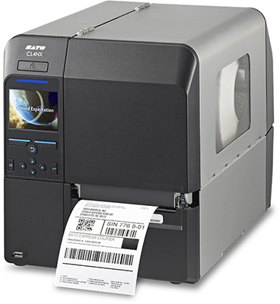
SOS Architecture
Customer
HTTPS (443)
Agent Update
(Github)
SATO Printer
Messaging Protocol/Broker
MQTT (8883)/
WebSocket (443)
Remote technical support via SOS, phone or email during normal operating hours
HTTPS (443)
Web Service
HTTPS (443)
SOS Web
HTTPS (443)
HTTPS (443)
SOS is using 2 communication ports i.e. Port 443 and Port 8883.
If customer can’t open port 8883 for MQTT, MQTT over WebSocket (443) protocol can be used for real time connection.

Slide 5
SOS Check Points Review
Point 2
Customer
HTTPS (443)
Agent Update
(Github)
SATO Printer
Point 1
Point 4
Messaging Protocol/Broker
MQTT (8883)/
WebSocket (443)
Point 5
Technical support with live operators via SOS, phone or email during normal operating hours
Point 3
HTTPS (443)
Web Service
HTTPS (443)
SOS Web
Point 6
HTTPS (443)
HTTPS (443)
In order to ensure SOS communication are secured and protected, in each check point we implement security check.

Slide 6
SOS Check Points Review
Check point | Route | Port | Function | Security Countermeasure
Check point 1 | Printer | 443 /8883 | Operate SOS | Disable any service in Linux except printer functionality. TLS is implemented.
Check point 2 | Printer - agent update (Github) | 443 | Device authorization and update SOS agent | Printer authorization. Encrypt communications (TLS 1.2)
Check point 3 | Printer - Web Service | 443 | Device authorization | Printer authorization. Encrypt communications (TLS 1.2)
Check point 4 | Printer – Broker | 8883 | Device authorization and change printer setting information. | Printer authorization Encrypt communications (TLS 1.2)
Check point 5 | Broker - Web service | 443 | Sharing device information (authorization information) | Encrypt communications (TLS 1.2)
Check point 6 | PC or mobile devices - Web service | 443 | Account information. View printer information, | Encrypt communications (TLS 1.2) SOS meets with ASVS (Application Security Verification Standard).
3 types of countermeasures:
Encrypt all communication.
Install protection at all check points.
Prevent unauthorized access.
AWS supported minimum TLS 1.2
SOS is safe and secured application.

Slide 7
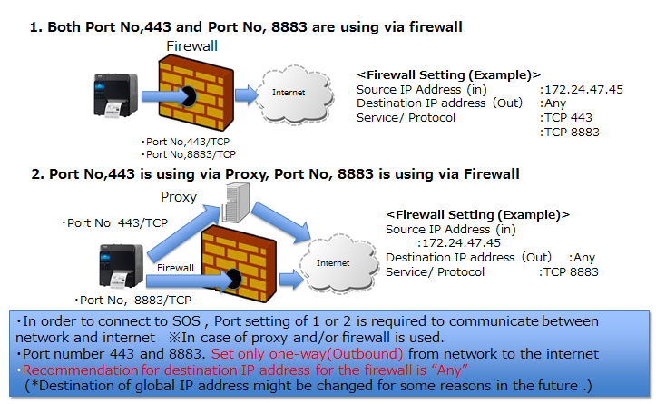
Firewall Configuration
Network Requirement for SOS

Slide 8
Information to be sent to SOS
Periodic update (Data size : less than 5KB)*
Error notification (Data size : less than 5KB)*
Printer status and printer setting data are sent to MQTT broker with 60 minutes interval after turning on the printer.
Printer event such as an error, an alert and a warning are sent to MQTT broker from printer.
Print data of your printer will not be sent to the SOS cloud server unless the data is uploaded manually by customer into SOS Web app.
Print data
* This is based on general assumption
* This is based on general assumption
Data size sent to the SOS are very light. Therefore, impact to customer network bandwidth is limited

Slide 9
Notification and Error Contents
◇ Notification
◇ Error
Category | Contents
Printer status | Power Save Power Down Online Offline Error Warning
Printer Usage | Label Count Cutter Count Life Counter Uptime Head Resistance
Printer Setting | Print Speed Print Darkness Darkness Range Sensor Print Move Backfeed Serial Number Firmware
Category | Contents
Error | Error, Alert, Warning

Slide 10
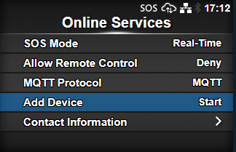
Changing of Printer Settings
Access to a printer by command
Prohibit printer settings change remotely
SATO will not be able to reach your printer in your network. (PING from outside is not reachable).
A printer setting option is available to set whether or not to allow settings the printer (remote control) from SOS Web Application.
Printer setting can only be changed via command of web application or SATO Helpdesk via SOS cloud server.
Periodic update or error notification will not be disabled even if prohibited setting (Deny) is enabled.
Customer has full control of their security network. Customer can give SATO permission to remotely access or prohibit remote control of printer settings.

Slide 11
Required Printer Network Configuration
1. Set Printer IP address, subnet mask and default gate way
2. Set DNS
3. Set IP address and Port number for proxy server
These settings are not required if DHCP is selected.
DNS is not required if DHCP is selected.
This step is not required If proxy server is not used.
Up to three DNS can be set.

Slide 12
©2020 SATO Global Business Services Pte. Ltd. All rights reserved.
This document is prepared based on information as of Nov 2021.
Specifications subject to change without notice.
Any unauthorized reproduction of the contents of this presentation, in part or whole, is strictly prohibited.
SATO is a registered trademark of SATO Holdings Corporation and its subsidiaries in Japan, the U.S. and other countries.
All other trademarks are the property of their respective owners.

